Slide 1
Respondus Lockdown Browser Training
Dr. Sara Albert
Department of Natural Sciences
SLCC
sara.albert@solacc.edu

Slide 2
Respondus Lockdown Browser
Overview of the Respondus Lockdown Browser
What is the Respondus System?
How do I download it?
Student Resources
Setting up the Respondus System in Canvas
Information for the students
Setting up an assessment with the Respondus Lockdown Browser in Canvas
Respondus Lockdown Browser Publisher Resources
Webinars
Support
Notes:
The Respondus Lockdown Browser:
This is a proctoring system where the Lockdown Browser is a web browser the student is required to use for test taking.
It prevents the student from printing, taking screen-shots or accessing the internet via other means on their computer.
If you add a web-camera to this, it’s called the Respondus System.
It ensures that it is the student who takes the exam, and nobody else.
It provides video footage of the student taking the exam and is a deterrent to cheating.
The instructor require that the Respondus System is used for select quizzes or exams in Canvas.
The video will be generated with about a day’s delay.
The instructor can review the video in Canvas.

Slide 3
Respondus Lockdown Browser
Notes:
This is how I introduce the Respondus System in Canvas.
In the “Getting Started” module – which is the first module the student is required to complete, I include the Respondus Lockdown Browser Information.
The “Proctored Exams – Instructions on download and use of Respondus Lockdown Browser” page (we will view it in subsequent slides) language is posted in the “Remote Instructions Workgroup” Canvas course, in the “Respondus Monitor Resources” module, in a Canvas page called “Dr. Albert’s Respondus Resources”.
If you don’t have access to the course email Maia Smith: maia.smith@solacc.edu
The “Respondus Lockdown Browser Getting Started Guide” is a link to a Quick Start guide pdf-file (a link is provided in this Power Point and in the “Remote Instructions Workgroup” course ).
The page called “Demonstration of correct use of Respondus” is a page with the Demo-video embedded (you can create this page using the embed code provided in this PowerPoint. The video is also posted in the “Remote Instructions Workgroup”).
The “Test Quiz” is a Canvas quiz that is set up to require the Respondus System. This is discussed further on in this Power Point.

Slide 4
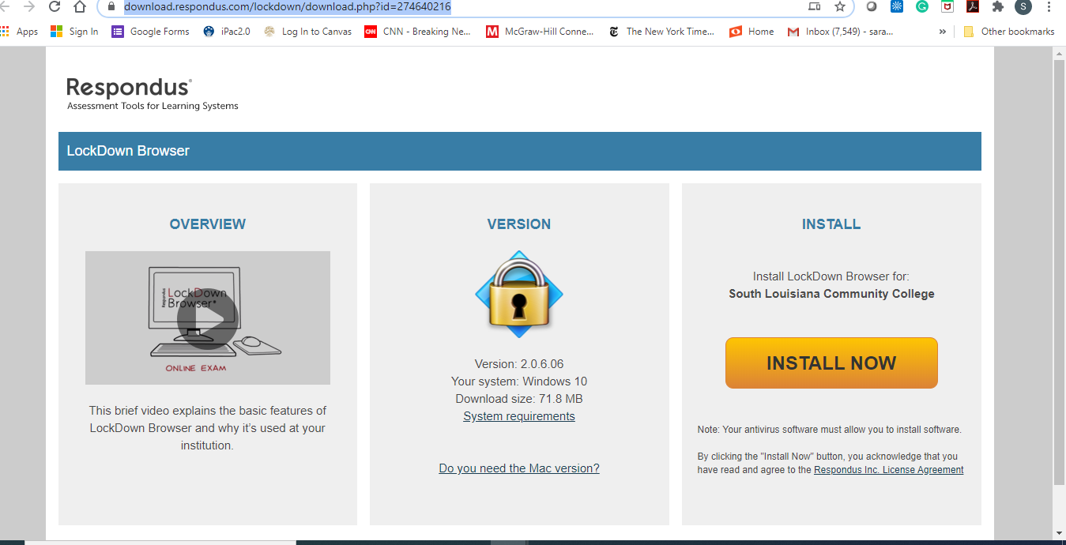
Respondus Lockdown Browser Download Link for Canvas
https://download.respondus.com/lockdown/download.php?id=274640216
Notes:
This Lockdown Browser download link is specific for SLCC – follow it to watch an information video and to install the Lockdown Browser.
This link is provided for the students in the “Proctored Exams – Instructions on download and use of Respondus Lockdown Browser” page

Slide 5
Student Instructions Respondus Lockdown Browser
Student Respondus Instruction Video
https://web.respondus.com/lockdownbrowser-student-video/
Student Quick Start Guide
https://www.respondus.com/downloads/RLDB-QuickStartGuide-Instructure-Student.pdf
Notes:
The links to the Respondus System instructions – video and a quick start guide - can be posted in Canvas for your students.
I include those in the “Proctored Exams – Instructions on download and use of Respondus Lockdown Browser” page for the students.

Slide 6
Instructions in Canvas
I have generated a Canvas Page with instructions for the students .
The contents of this page is posted in the “Remote Instruction Workgroup” Canvas course
Respondus Monitor Resources Module
“Dr. Albert’s Respondus Resources”
Ask Maia Smith for access maia.smith@solacc.edu
Notes:
I generated this Canvas page with instructions on how to use the Respondus System.
I have shared this Canvas page with Maia and it is posted in the “Remote Instruction Workgroup”, in the “Respondus Monitor Resources” module, in a Canvas page called “Dr. Albert’s Respondus Resources”.
Feel free to use this page in your Canvas course. You may modify it to suit your course.
It contains instructions on how the student is expected to use the system, links to the instruction video and a link to download the browser as previously shown.
Instructions on how to access an exam or quiz with the Lockdown Browser and how to reach Technical Support.

Slide 7
Demo-video
Embed code:
<iframe width="560" height="315" src="https://www.youtube.com/embed/gWLoW5p9Q-Y" frameborder="0" allow="accelerometer; autoplay; encrypted-media; gyroscope; picture-in-picture" allowfullscreen></iframe>
https://youtu.be/gWLoW5p9Q-Y
Notes:
I generated a demo-video of the environmental check for students to view.
I have shared this video in the “Remote Instruction Workgroup” course: Go to the “Respondus Monitor Resources” module and check the Canvas page called “Dr. Albert’s Respondus Resources” in that module.
I have included an embed code on this slide, as well as the video.
In my experience, this is what students need guidance and feedback on.
I require the students to take a Test Quiz that requires the Respondus System that is not graded.
They can retake it an unlimited amount of times.
I review the videos and provide feedback on their use of the system.
If they do not perform the environmental check correctly, I refer them to the demo-video and request that they retake the Test Quiz.
If their ID is blurry I ask them to email it to me instead. It is sometimes hard for them to get it right in the video.

Slide 8
Setting Up a Quiz or Exam with Respondus
Notes:
Find the “Lockdown Browser” link the in the left-hand menu in Canvas

Slide 9
Setting Up a Quiz or Exam with Respondus
Notes:
Click on the “Continue to Lockdown Browser” tab.
This is important to remember if you import contents into a new course:
If you start a new course with Respondus System assignments you need to do this step in order to activate the system in your new course section.
If you don’t do it the students cannot access the assignments with the Lockdown Browser.

Slide 10
Setting Up a Quiz or Exam with Respondus
Notes:
All assignments that could possibly be taken with the Respondus system are listed as you click on the link in the previous slide.
You can now choose which ones should require the Lockdown Browser and the Respondus Monitor.

Slide 11
Setting Up a Quiz or Exam with Respondus
Notes:
Click on the arrow to the left by the assignment name.
In this case I have clicked on the Test Quiz.
Now I can select the settings.
Require or do not require Lockdown Browser.
There is also an option to require an access code if you use a live proctor and not a webcam.
You would provide the code that you enter here for the proctor.
This way, the student can only access the exam as the proctor enters the code.

Slide 12
Setting Up a Quiz or Exam with Respondus
Notes:
You would also modify the start-up sequence for the student here.
If you click on “Preview” the instructions pull up for each item, so you can preview what the student would see.

Slide 13
Setting Up a Quiz or Exam with Respondus
Notes:
You can opt to require facial detection or not.
You can enter a test student in the advanced settings for your own use.
Save and close.

Slide 14
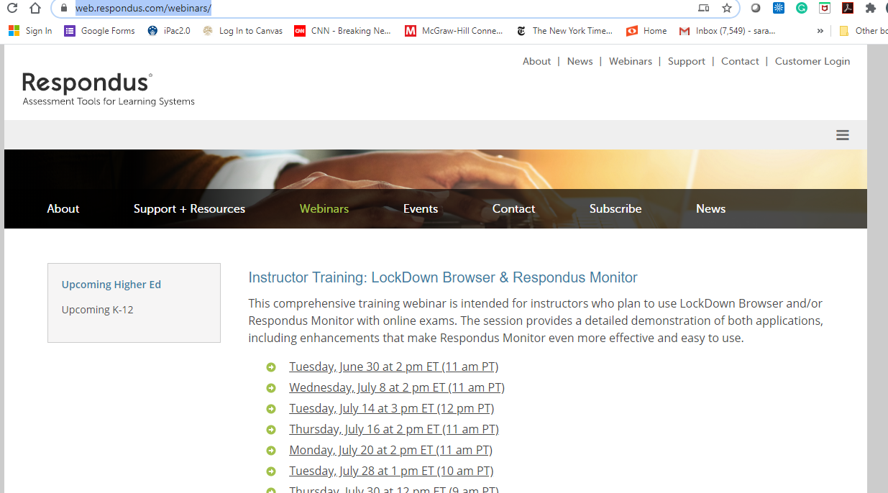
Respondus Training Webinars
https://web.respondus.com/webinars/
Notes:
Webinars are offered frequently through the company.

Slide 15
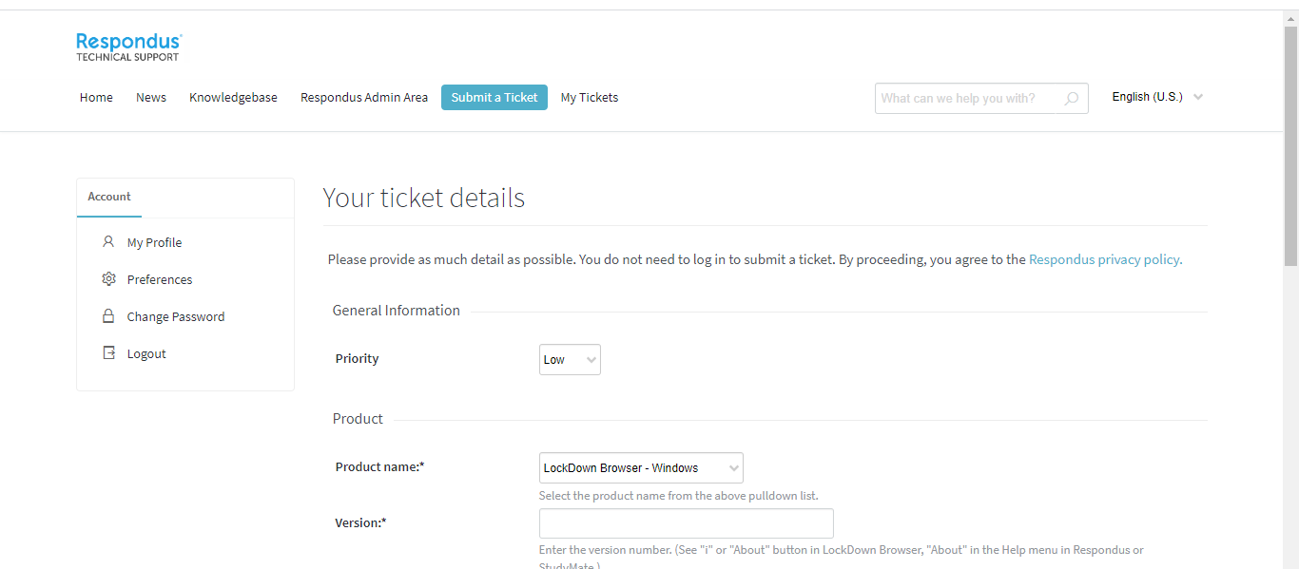
Respondus Support Page
https://support.respondus.com/support/
Notes:
This is the Respondus Support Page.
This is where the student would submit a help ticket.
I require the student to submit a ticket for the record if they experience technical problems.

Slide 16
Questions?
sara.albert@solacc.edu
Notes:
Feel free to contact me at sara.albert@solacc.edu, in case you have any additional questions.

